Slide 1

TAKE THE SEAT
Presented by the Ohio Progressive Caucus
January 18, 7:30pm

Slide 2
INTRODUCE YOURSELF
While the Ohio Progressive Democratic Caucus leadership introduces themselves, in chat, please give your:
Name
County
Why you’re here
Have you decided to run?

Slide 3
Membership Link/Socials?
Chair: Kim McCarthy
Vice Chair: Will
Secretary: Amana Koeller
VC of Communications: Stephanie Wasson
VC of Policy:
VC of Membership
VC of Rules and Bylaws

Slide 4
Membership Link/Socials?

Slide 5
OUR VISION AND GOALS
Our Vision Build a Democratic Party in Ohio that fights unapologetically for working people and delivers real material improvements in people’s lives.

Slide 6
OUR VISION AND GOALS
Long-Term Goals
Elect Democrats who will pass bold policies that make life more affordable and reduce income and wealth inequality in Ohio
Build governing coalitions of elected Democrats at the local and state level committed to improving people’s material well-being
Transform the Ohio Democratic Party into a party of the people by participating locally — free from corporate and dark money influence

Slide 7
OUR GOALS (BUILD POWER TO WIN)
Medium-Term Goals (2026–2027)
Grow to 1,000 members by the end of 2026
Build caucus presence in 80% of Ohio counties by 2026 and 100% by 2027
Increase participation of working-class Ohioans in party leadership
Pass a resolution in the ODP against dark money in Democratic primaries before 2028.
Short-Term Goals (Now–2026)
Fully formalize the Progressive Caucus (leadership, bylaws, communications, membership)
Develop 3–5 clear, populist policy priorities for 2026 candidates
Reach 350 members by the end of 2025 (we’re at 500!)
Increase and recruit precinct captains and active member involvement in their county party

Slide 8
What are we covering?
Do you know you have a local county Democratic Party?
Do you know what Central/Executive Committee is?
Have you ever been elected or appointed Central/Executive Committee?
Did you know that there is also a State Central Committee for the Ohio Democratic Party (ODP)?

Slide 9
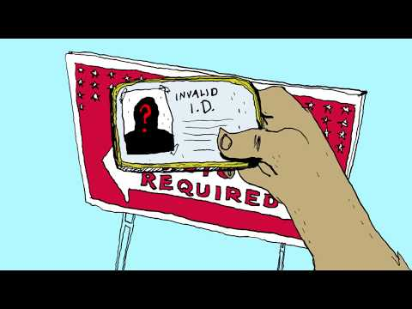

Slide 10
Discussion of Video
The video is for New York, but the setup is the same in Ohio.
Having active people participate in local, state, and national sections of the party are imperative and universal themes across the nation.
The party is made up of WHO SHOWS UP, so we need to SHOW UP.
LOCAL WORK = COMMUNITY BUILDING WORK

Slide 11
Why join your county party?
Several important offices will be on the ballot in 2026, including:
County races
Local judicial races
State Representative (all 99 districts)
State Senate (Odd numbered)
U.S. Congressional Districts
U.S. Senate (special election)
Governor and entire statewide ticket.
Supporting a strong, competitive slate of candidates takes preparation, organization, and community involvement. The county party plays an important role in that work by helping coordinate volunteers, share information, and build connections across precincts. You are on the FRONT LINES OF ELECTING CANDIDATES – UP AND DOWN THE BALLOT!

Slide 12
What is Central Committee?
Your County Democratic Party’s Central Committee is comprised of all elected representatives from each of the precincts that make up your county, these seats are on the ballot every 2-4 years in the primary election.
This committee is responsible for electing party leadership every 2-4 years during the reorganization which happens within 30?? days of certification of the primary.

Slide 13
What is Executive Committee?
The Executive Committee (EC) functions as the governing body of the Party, and its members are commonly referred to as Precinct Captains/Executives/leads, with larger counties having Ward leaders (over a group of precincts).

Slide 14
What is the difference?
The “Executive Committee (EC)” consists of:
all members of the “Central Committee”
all elected officials who are Democrats.
at-large appointees with full voting privileges, same as the Central Committee members can be appointed – up to 1 less than the number of members elected on the Central Committee.
The Central Committee only comes into play again in certain circumstances regarding open elected seats, primarily.

Slide 15
What does a Precinct Captain (PC) do?
As the lead Democrat in your neighborhood/precinct, you function as
Organizers of like-minded folks within the precinct
a direct line of communication between those residents, the Democratic Party, and its elected officials.
an integral part in both the internal and external operations of the party.
Ensuring Democrats in your precinct are informed and come out to VOTE EVERY TIME is the basic goal.

Slide 16
Precinct Captain Job Description
Internally, by serving on the Executive Committee, PCs are the only people who can vote on party related matters. These EC Meetings take place at least 4 times per year, but may take place more often as needs arise.
It is here that PCs vote to
Elect Party Leadership,
Appoint PCs to vacant precincts in between elections,
Make changes to the Party Constitution and By-Laws,
Appoint Officials to vacant offices, (CC only)
Vote to endorse candidates in Democratic Primaries.*Not applicable in all counties or races.
PC attendance at these meetings is critical, since it ensures that the voices of residents from the various communities in Your County are heard.

Slide 17
Precinct Captain Job Description
Externally, PCs are vital to the success of the Democratic Party because they provide localized, committed, and enthusiastic support for Party initiatives during and between elections. PCs participate in Democratic campaign activities such as:
Voter registration
Attendance at monthly Regional Meetings with their Democratic neighbors
Sharing important election information such as times, dates, polling locations, and early voting information
Distributing candidate and Party literature that they receive from the Party
Helping the Party secure yard sign locations
Volunteer recruitment and organizing, and
Organizing around local issues of concern.
PCs can also participate in Party fundraisers, and volunteer to work on campaigns, help around the office, and more generally, represent Democratic values at their places of work and in their communities every day.

Slide 18
How to Become a Member of Your County Democratic Central Committee
To become a PC for your county Democratic Party:
1. you must be a registered voter who lives in that precinct
2. you must consider yourself a Democrat.
3. You cannot run to become a PC if you voted in a Republican Party primary in the past 2 years.
4. Complete and submit Form 2-M or form 2-J by the filing deadline of Feb 4, 2026. If you’re unsure of what form you need, check with your county BOE.
5. Contact your local Democratic Party and introduce yourself and your new endueaver
* If elected, you will be required to swear an oath to uphold the Constitution and by-laws of the Your County Democratic Party.
This happens every 2-4 years depending on your county. If you don’t file by Feburary 4th, there’s still a way to be an At-Large Precinct Captain

Slide 19
How to become a member of Your County Democratic Central Committee
Insert image of forms here

Slide 20
Why Is This Position Important?
We need to work together in numbers large enough to make a difference. This network of PCs across the state will enable us to get candidates elected by:
Mobilizing voters/GOTV to increase voter awareness and turnout
Talking to our neighbors to heal the division, and to show we all want the same thing - the ability to live a life with dignity.
Bringing folks together to build community against the fascist crisis we face.
We need your help - and we are making a commitment to help you win - you can know your efforts are making a difference where it matters, right here in your own backyard. Local work matters.
We have the tools and experience to guide you.

Slide 21
What about State Central Committee?
The Ohio Democratic Party operates in the same way, with their members of their Central Committee coming from across the state. Each State Senate district is represented by a male and a female member. 33 districts x 2 members = 66 State CC members.
These seats are up every 4 years. (May 2026 upcoming)

Slide 22
Why is this seat important?
The Ohio Democratic Party is made up of the people who show up. If you want your voice to be heard in the ODP, we urge you to run for the State Central Committee.
We need people who share our values and goals to run for these seats who can shift the Democratic Party towards the people in Ohio. We need to challenge the status quo and fight for a party that truly shows up to improve the lives of the people of Ohio.

Slide 23
What are next steps?
Complete Form Form 2-J for the State CC seat.
For State CC seats, make sure you return it to the most populous county in your senate district
Contact the county parties in the senate district to let them know about your new campaign to win your seat on May 5th
*create slide on getting appointed after the reorg, if the filing deadline is missed, or you want to join in later.

Slide 24
What if my county is not up for reelection right now?
Reach out to your county chair or BOE, if you don’t have an election, you can still be appointed at-large!
At-Large appointees can happen all year round and still lead to more progressive representation.

Slide 25
What can organizing your county look like?
FOR THE FIRST TIME, WE ARE COORDINATING ACROSS THE STATE AROUND THE SAME GOALS – MAKING OUR PARTY MORE PROGRESSIVE, SO WE CAN GET THE PUBLIC POLICY WE NEED TO REDUCE INCOME INEQUALITY. AKA GET OUR PARTY AWAY FROM THE MONEY AND TOWARDS THE PEOPLE.
Rep Your Block 2020 – Franklin County (Will)
Rep Your Block 2026 – Cuyahoga County (Keith)
Cincinnati Precinct Project – Hamilton County (Jack)

Slide 26
RepYourBlock2020 - Franklin County (Will)
The Franklin County Democratic Party today | A more democratic Franklin County Democratic Party
Exclusive / good ol’ boys club Closed and lacks transparency Accountable to the wealthy few Stopping / limiting true progress People are left out of decisions that impact their lives Little to no community engagement The “old guard” - “Get in line. Wait your turn” | Inclusive & open Radically transparent Accountable to the people Progress/ policy change that improves our communities Listening & connected to every neighborhood Building leaders across the county Guided by values and a vision for change We’re tired of being told to wait.

Slide 27
Rep Your Block 2026 – Cuyahoga County (Keith)
Text

Slide 28
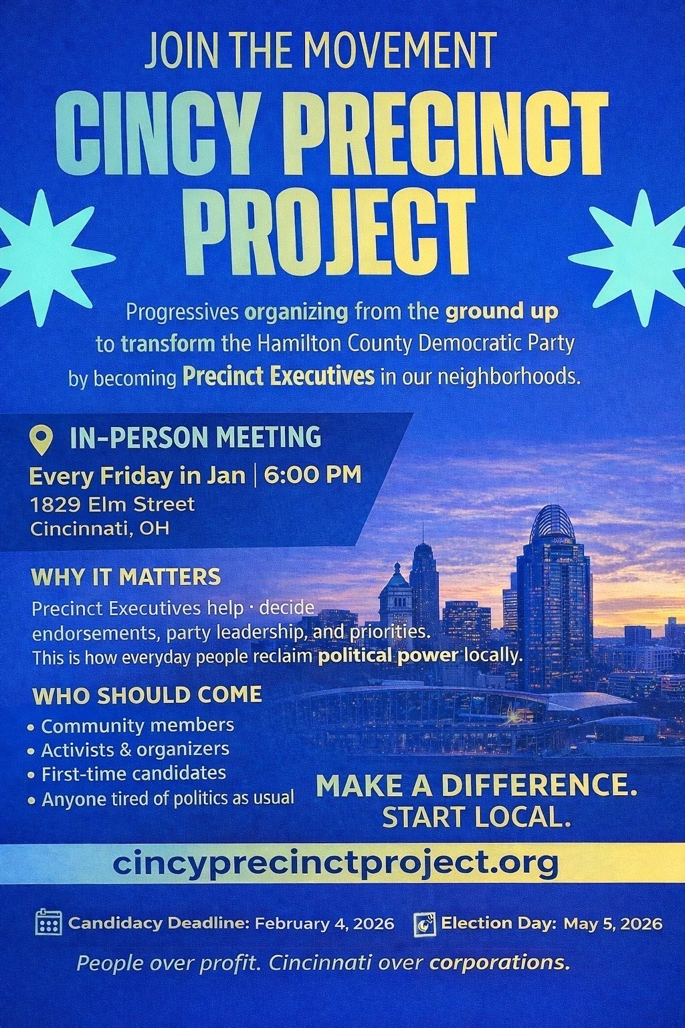
Cincinnati Precinct Project – Hamilton County (Jack)
This project has been happening since the summer of 2025. In that time we have recruited over 140+ people, and have filed 91 people’s paperwork.
This is the first time a project like this has been undertaken in Hamilton County. We’re going to be continuing our recruitment to this campaign to the deadline, and make sure we get everyone set up for the campaign season.

Slide 29
Any Questions?

Slide 30
Membership Link/Socials/Dicsord through Reg Lead?
Text

Slide 31
Membership Map
Text

